Slide 1

Data Analysis Report

Slide 2

Background
The purpose of this presentation is to show some visuals of information obtained from the data base and analyze trends from the data using Power BI.
The dataset was obtained from Kaggle.
The data consisted in around 3000 samples.
The data set was presented in .csv format (Excel)
Data comes from a retail company which sells and ships orders of different types of vehicles.

Slide 3
Strategies
Investigate the reason for cancellation of orders. If the cancellation was a customer decision, then for the following years we could predict an approximate number of cancellations considering an increase or decrease on sales every year. The objective of this strategy is to make just enough vehicles for the company to avoid costs on building vehicles that will not sell.
If the cancellation was a decision of the maker, investigate the causes, any bottlenecks in the process. The objective is to create a strategy to avoid future cancellations, which is directly impacting revenue.
By identifying the seasonality in which customers decide to buy most vehicles we could implement marketing strategies to increase those sales.
We could implement marketing strategies in countries that have potential for selling classic cars after doing some research we could compare our sales data with those countries and optimize our marketing strategy to take advantage of the market.

Slide 4
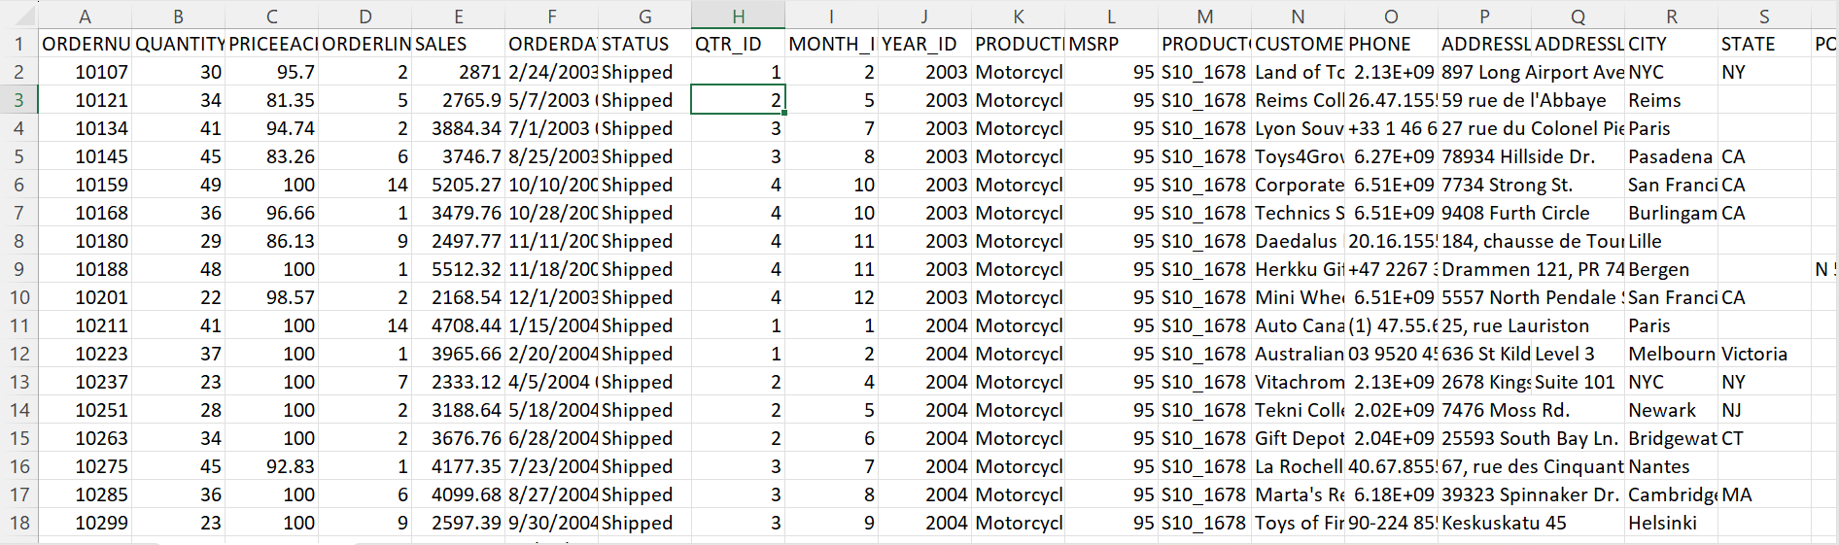
Dataset

Slide 5
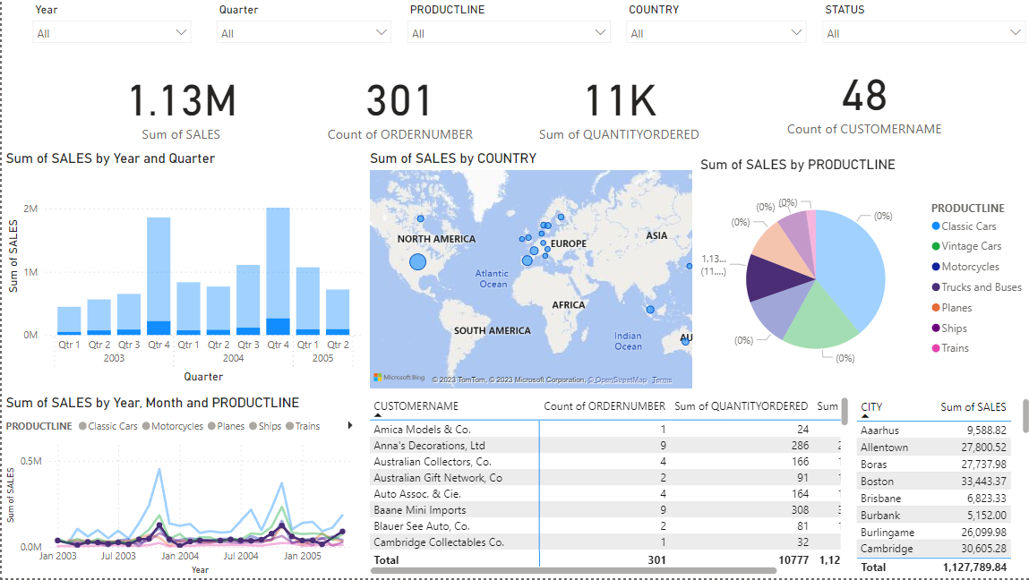
Interactive Dashboard

Slide 6
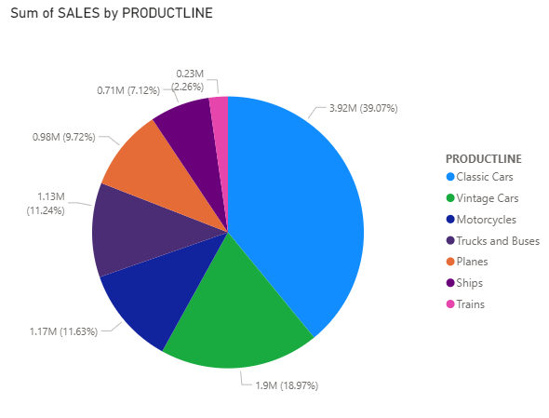
Sales per product
Popular products are:
Classic cars
Vintage cars

Slide 7
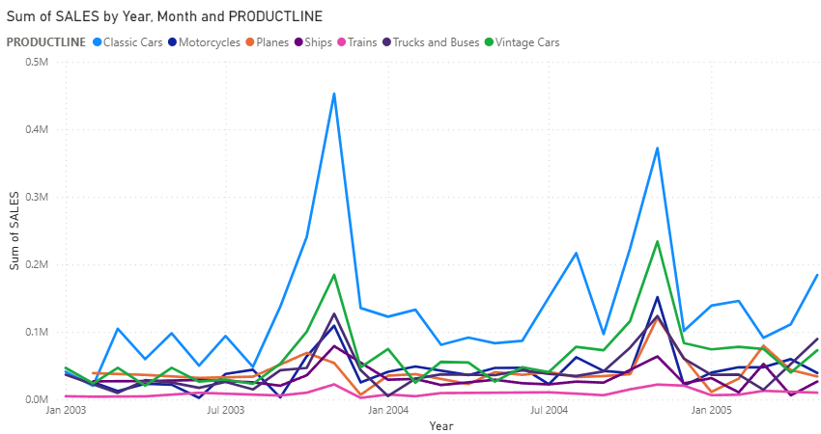
Sales per product per month

Slide 8
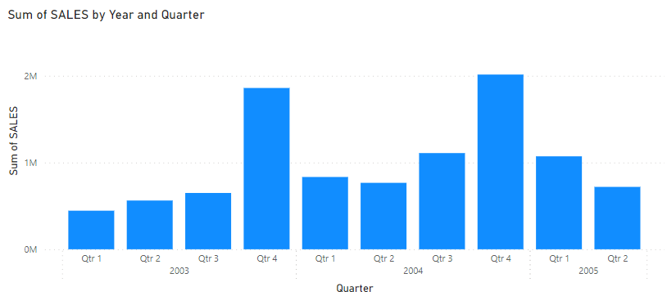
Sales in 2003, 2004 and first 2 quarters of 2005
Note the increase of sales on the 4th quarter on each year

Slide 9

Classic Cars

Slide 10
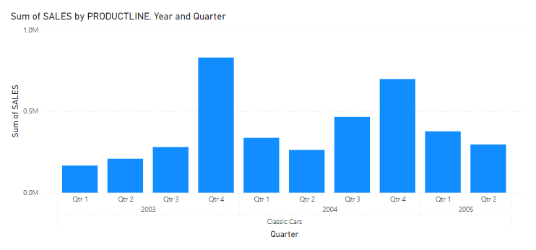
Sales on classic cars
Note that between all quarters there is a small increment as time passes except between the 4Th quarter from 2003 to the 4th quarter of 2004
Also note that the quarter with most sales in each year is the 4th quarter

Slide 11
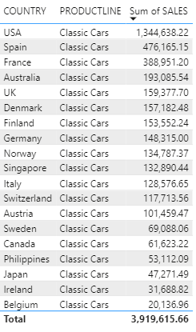
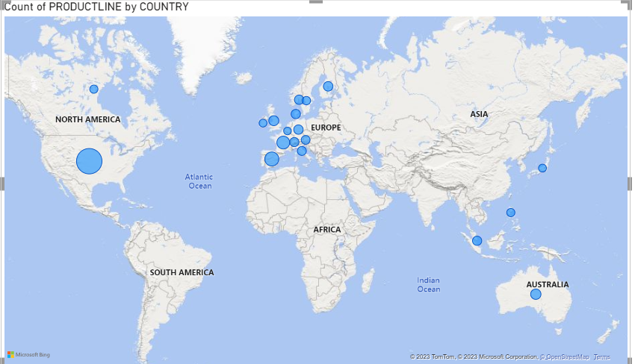
Sales per Country
Note that the first three clients are USA, Spain and France

Slide 12

Vintage Cars

Slide 13
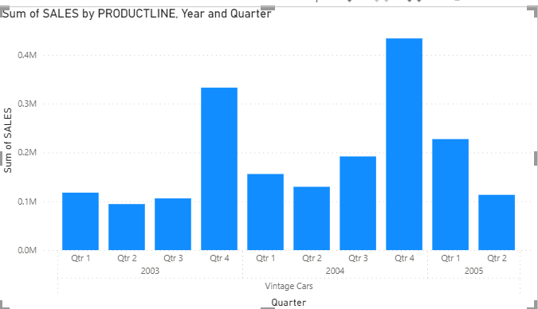
Sales on vintage cars
Note that there is an increase in each quarter between the year 2003 and 2004
Note that there was a slight decrease between the 2nd quarter from 2004 and the 2nd quarter on 2005

Slide 14
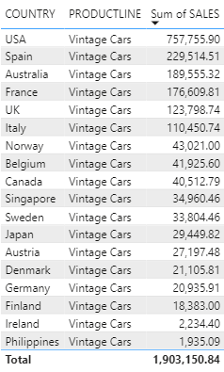
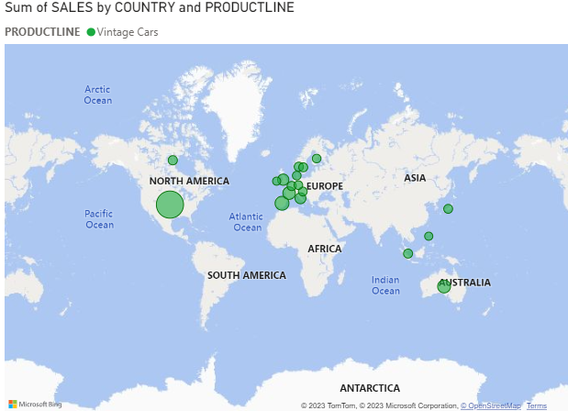
Sales per Country
Note that the first three clients are USA, Spain and Australia

